Slide 1




CREDIT CARD FRAUD DETECTION
Presented By : Anomaly Detectors

Slide 2

1
DATA PREPARATION
2
DATA VISUALISATION
TABLE OF CONTENT
3
MODEL SELECTION
4
HYPER-PARAMETER TUNING
5
EVALUATION AND RESULTS

Slide 3
PROBLEM
Can we detect potentially fraudulent transactions based on customer profiles and transaction behavior?
  The objective is to flag suspicious transactions as fraudulent.
  Use available features such as transaction amount, income category, demographic attributes (e.g., age, gender).

Slide 4

DATA PREPARATION
Combine dataset
  Merged Finance, Revenue Target, and Customer Info using CLIENTNUM as the unique identifier.
Drop Irrelevant Columns
  Year, Date, credit limit.
Check for missing variables

Slide 5
LABELING CATEGORICAL VARIABLES INTO INTEGERS
Customer_Age:
  0-16 → 0
  17-32 → 1
  33-48 → 2
  49-64 → 3
  More than 64 → 4
Marital_Status:
  Single → 0
  Married → 1
  Divorced → 2
Gender:
  M → 1
  F → 0

Slide 6
LABELING CATEGORICAL VARIABLES INTO INTEGERS
Income_Category:
  Less than $40K → 0
  $40K - $60K → 1
  $60K - $80K → 2
  $80K - $120K → 3
  Greater than $120K → 4
Card categories:
  Blue → 0
  Silver → 1
  Gold → 2
  Platinum → 3

Slide 7
DEFINING FRAUDULENT BEHAVIOR USING IQR
We flag a transaction as fraudulent (Attrition_Flag = 1) if its Trans_Amount is unusually high for its income group.
For each Income group, calculate:
  Q1 = 25th percentile
  Q3 = 75th percentile
  IQR = Q3 - Q1
Upper Bound = Q3 + 1.5 × IQR
  If Trans_Amount > Upper Bound → Attrition_Flag = 1
  Else → Attrition_Flag = 0

Slide 8
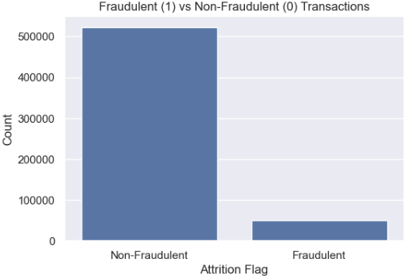
DATA VISUALISATION

Slide 9
ATTRITION_FLAG RATE
Number of fraudulent transactions (Attrition_Flag = 1): 50451
Number of non-fraudulent transactions (Attrition_Flag = 0): 522553
Total transactions: 573004
Fraudulent percentage: 8.80%

Slide 10
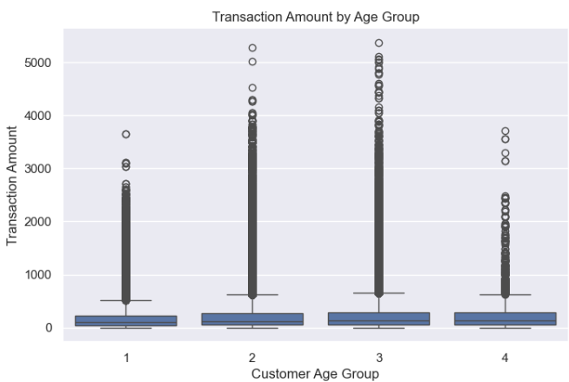
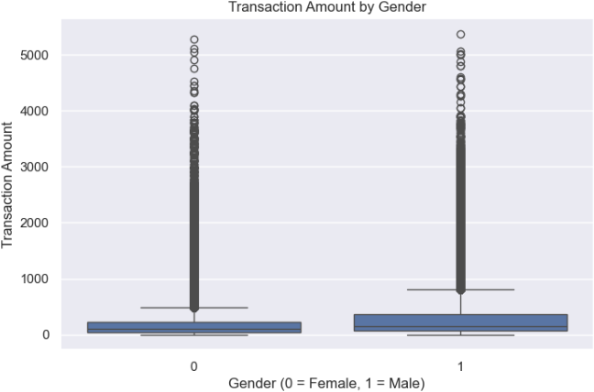
DATA VISUALISATION

Slide 11
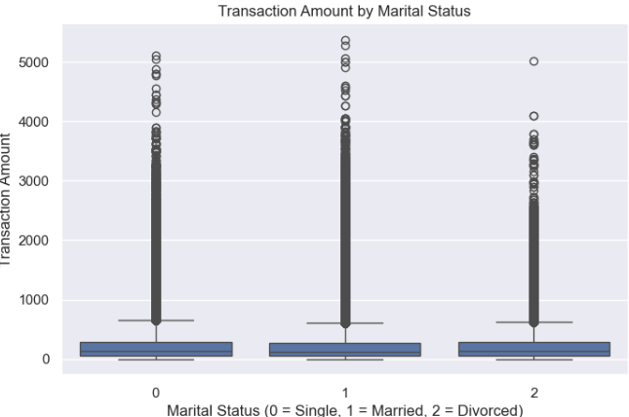
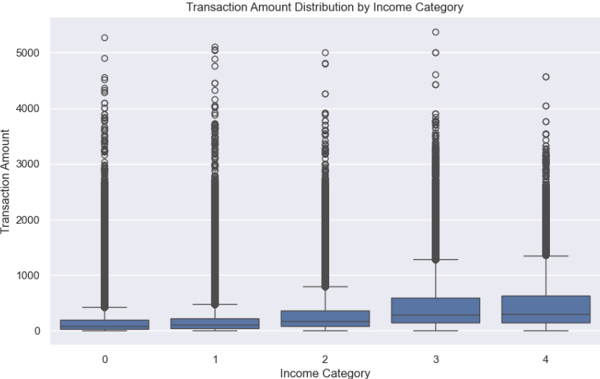
DATA VISUALISATION

Slide 12
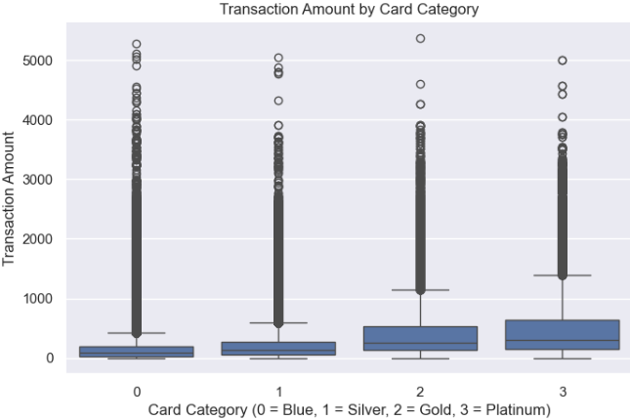
DATA VISUALISATION

Slide 13
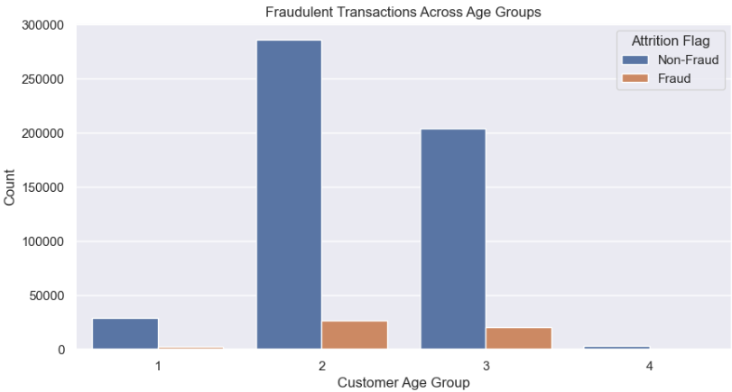
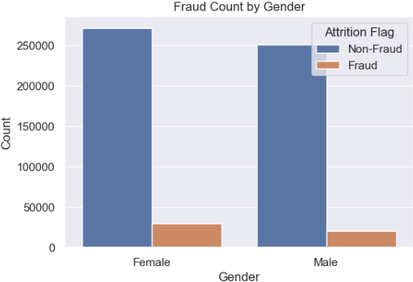
DATA VISUALISATION

Slide 14
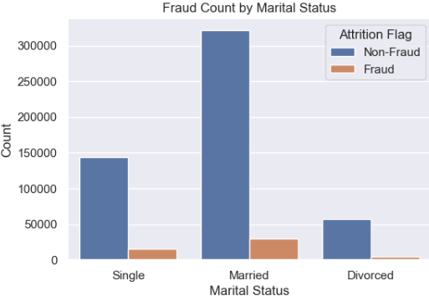
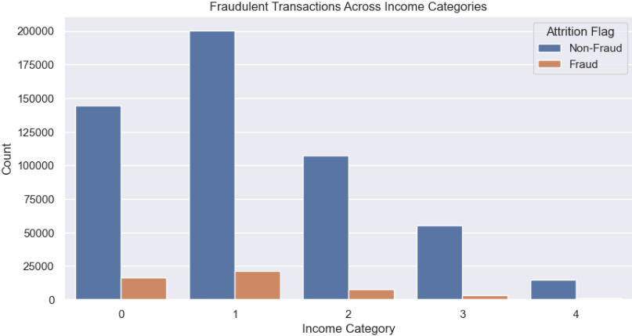
DATA VISUALISATION

Slide 15
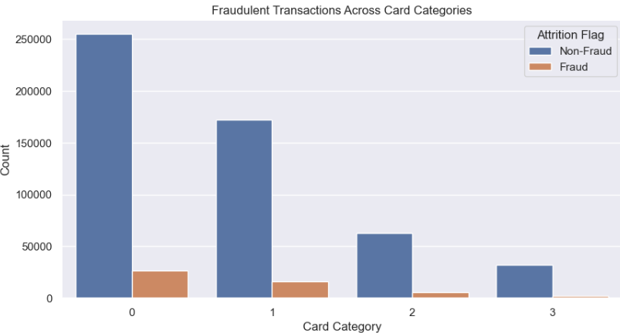
DATA VISUALISATION

Slide 16
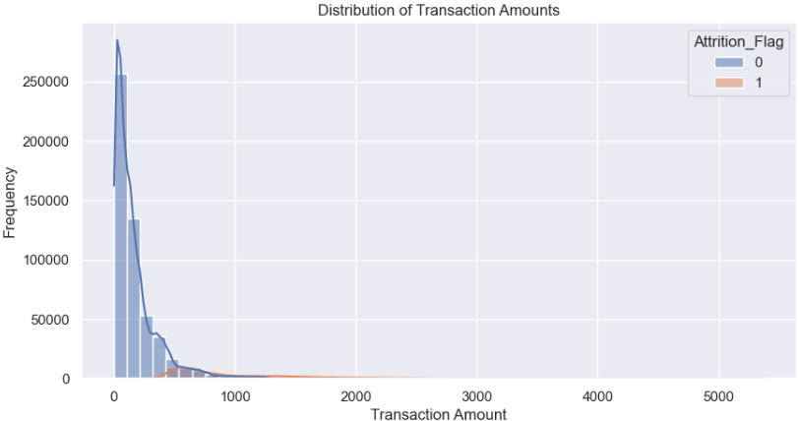
DATA VISUALISATION

Slide 17
MODEL
1
RANDOM FOREST CLASSIFIER
2
DECISION TREE CLASSIFIER
3
LOGISTIC REGRESSION
4
NAIVE BAYES

Slide 18
UNBALANCED AND BALANCED DATA
  Unbalanced Data: Biased towards the majority class because it has many more examples to learn from. Poor in detecting the minority class leading to low recall and misleading accuracy.
  Balanced Data: SMOTE is used to train the model to have equal number from both classes. Improve recall and precision for the minority class. As a result, the model is better at detecting fraud and generalizes better.

Slide 19
PERFORMANCE
The performance is evaluated using:
  Accuracy: Overall correctness of the model.
  Confusion Matrix: To examine True Positives (TP), True Negatives (TN), False Positives (FP), and False Negatives (FN).
  Classification Report: Includes precision, recall and F1-score.

Slide 20
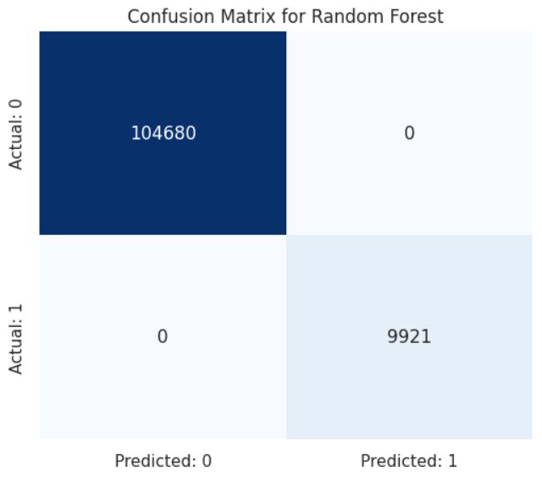

MODEL
Precision 1.00
Recall 1.00 → Data Leakage/Overfitting
F1-score 1.00

Slide 21
CROSS VALIDATION
  5 fold cross validation to evaluate the performance
  Both models perform well but the Random Forest is slightly more stable while the Decision Tree is more prone to overfitting
Results:
Random Forest CV scores: [0.99832462 0.99965096 0.99993892 0.99994764 0.99942408]
Decision Tree CV scores: [0.99990401 0.9999651 0.99998255 1. 1. ]

Slide 22


MODEL
Precision: 0.8919
Recall: 0.8637
F1-Score: 0.8776
Precision: 0.6187
Recall: 0.7731
F1-Score: 0.6873

Slide 23
Regression

Slide 24
How is regression going to help us with fraud detection:
1) Train regression model using the data. Using Transaction amount as the response variable(target) and the features in regression model.
2) Make predictions for new incoming transactions. Predict the expected new transaction(with the relevant features) using the model.
3) After generating the predicted values based on the features, can check to see if that predicted transaction amount actually exceeds the upper bound.
4) Flag accordingly if Predicted Transaction is higher than upper bound.

Slide 25
Key Points:
Must ensure that regression model is not biased and has a great matching capability.
It would be excellent if the predicted values based on the features perfectly(or almost) perfectly match the actual future values. Can use both MSE and R^2 to determine this.
R² = 1(closer to 1): A perfect fit.
A lower MSE indicates that the predictions are closer to the actual values, meaning the model is performing well.

Slide 26
3 Regression Models considered in project:
1) Linear regression
2) Support Vector Regression
- Linear model (Non-Linear not used)
3) Random Forest Regression

Slide 27
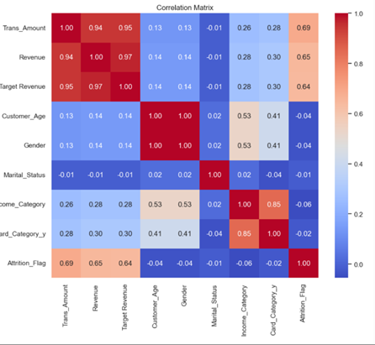
Correlation Heatmap (linear):
To see which features are mostly related to the transaction amount
From the heatmap, it can be seen that both Revenue and Target revenue are the closest to Transaction amount.
(Ignoring the attrition flag column/row)

Slide 28
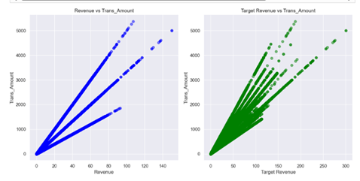
Explanation of why Linear Regression & SVR Linear used:
Before using Linear Reg./SVR, ensuring if features used are linear with the response variable(Trans_Amount). Done by using scatter plot, with trans_amount vs revenue & trans_amount vs target_revenue (individually)
Visually looks very linear. At the same time, correlation coefficient(r) of more than 0.94, linear regression may be appropriate and SVR linear appropriate(non-linear SVR not appropriate)
Correlation (Revenue vs Trans_Amount): 0.942 Correlation (Target Revenue vs Trans_Amount): 0.945

Slide 29
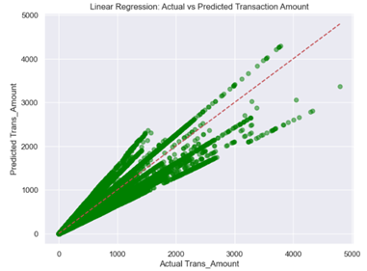
Linear Regression:
It is a statistical model that is used to model the relationship between a target variable(response) and one or more independent variables(features), by fitting a linear equation to the data. It assumes the relationship between variables are linear, i.e. any change in input feature will result in proportional changes in the output response. (Basic)
Using:
Response- Trans_Amount
Features- Revenue, Target_Revenue
Results of linear Regression:
Mean Squared Error (MSE): 10415.24
R² Score: 0.9053

Slide 30
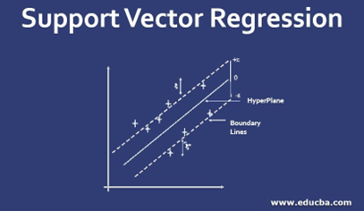
SVR(Linear):
SVR fits a regression line to the data, within an epsilon tube(defined margin) while allowing some errors outside the tube. Support vectors are also used, which are data point closest to the line, to determine the best fit.
Differs from linear regression by allowing errors within a margin and is more robust to outliers by focusing on support vectors that influence the model.
For our model a sample of 1000 was used due to speed issues. used k fold cross validation to ensure no biasness & no overfitting.
(5 folds)
Results of R^2(Avg)= 0.90

Slide 31
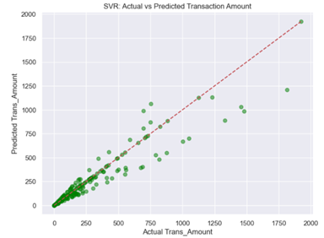
SVR(Linear):
Using:
Response- Trans_Amount
Features- Revenue, Target_Revenue
Results of SVR:
SVR MSE: 11614.44
SVR R² Score: 0.89
The R^2(avg) of the K-fold is 0.90. Which is very close to SVR R^2. Indicating low bias.

Slide 32
Random Forest Regressor
How Random Forest Regressor Works:
  It constructs multiple decision trees using random subsets of the data and random subsets of features for each node split.
  During prediction, each individual tree provides its own prediction, and the final prediction is the average of all these individual tree predictions.
One of the key concepts is the • Random Feature Selection: When splitting each node in a decision tree, only a random subset of features is considered. This helps in making the trees diverse and reduces the risk of overfitting.
Using:
Response- Trans_Amount
Features- Revenue, Target_Revenue, Card_Category_y, Marital_Status, Customer_Age, Gender, Income_Category

Slide 33
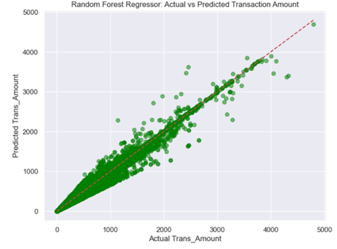
Random Forest Regressor
Results of Random Forest Regressor:
Mean Squared Error (MSE): 923.47
R² Score: 0.9916

Slide 34
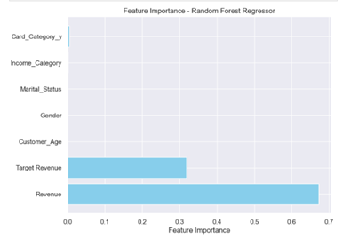
Feature importance:
Identifies which features are most influential in making predictions by calculating their contribution to improving model accuracy across all trees.
Identifying Key Predictors:
  Feature importance shows which features contribute most to the model's predictions. By focusing on these, you can reduce noise from irrelevant or weak features.
Improving Model Efficiency:
  Removing low-importance features can simplify the model, reduce overfitting, and speed up training—especially helpful when dealing with high-dimensional data.
Can be seen that Target_revenue and Revenue are most influential in making predictions.

Slide 35
Random Forest Regressor
Using:
Response- Trans_Amount
Features- Revenue, Target_Revenue
Results of Random Forest Regression:
Mean Squared Error (MSE): 1018.85
R² Score: 0.9907

Slide 36
Comparison the 3 models:
Best Regression Model
Linear Regression MSE: 10415.24
Linear Regression R² : 0.9053
SVR MSE: 11614.44
SVR R²: 0.89
RandomForestReg.: 1018.85
RandomForestReg.: R² : 0.9907
Best Model among the 3 Regression Models- Random Forest Regressor
Random Forest Regressor has the lowest MSE, much lower than the other 2 models. And this indicates error is much smaller than the others.
Furthermore, it has the highest R^2 value of 0.9908, so it explains 99% of the variance in Trans_Amount. Which is extremely strong.

Slide 37
After cross validation of Random Forest Regressor:
5-fold cross-validation done, meaning the data will be split into 5 subsets and the model will be trained and evaluated 5 times.
Results of Random Forest Regression(cross validation):
R² Score: 0.9990
Mean Squared Error (MSE): 109.30

Slide 38
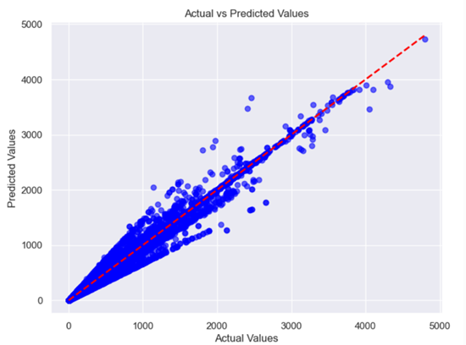
Hyperparameter tuning:
Hyperparameter tuning for a Random Forest Regressor involves adjusting parameters like the number of trees (n_estimators), maximum depth of the trees (max_depth), and the minimum samples required to split a node (min_samples_split) to optimize model performance.
Techniques like Grid Search used to find the best combination of hyperparameters by evaluating the model's performance on a validation set.
Results of Random Forest Regressor (After Hyperparameter tuning):
Mean Squared Error (MSE): 10571.62
R² Score: 0.8999

Slide 39

Regan
FINDING INDIVIDUAL PREDICTOR THAT BEST PREDICT FRAUD

Slide 40




Regan
SELECTED INDIVIDUAL PREDICTOR
For this section, we will be splitting our predictors into their individual dataframe and using the same confusion matrix function to predict fraud using
Random Forest Classification
CUSTOMER_AGE
GENDER
INCOME_CATEGORY

Slide 41

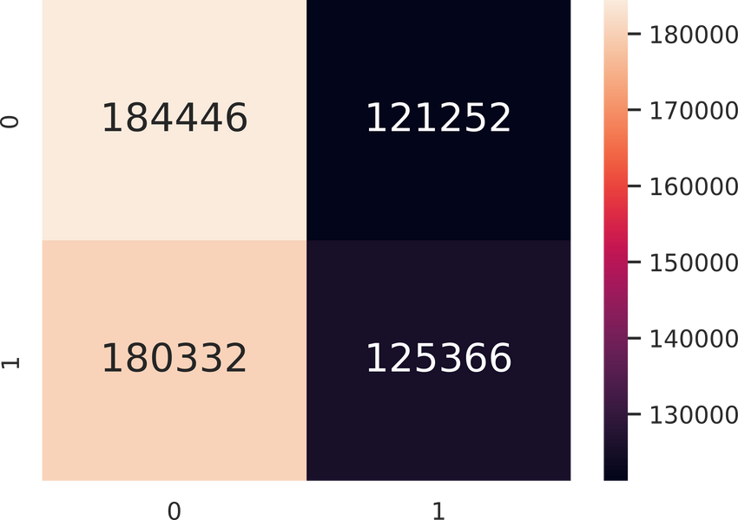
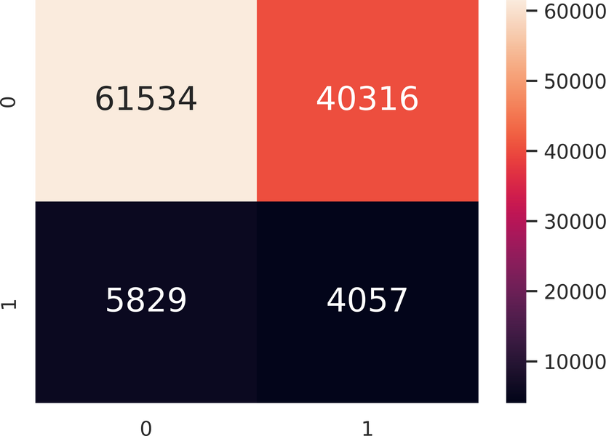
Regan
CUSTOMER AGE
Classification Accuracy in train data : 0.5067
Train Data - True Positive Rate : 0.4101
Train Data - False Positive Rate : 0.3966
Train Data - Precision : 0.5083
Train Data - Recall : 0.4101
Train Data - F1 Score : 0.4540
Classification Accuracy in test data : 0.5870
Test Data - True Positive Rate : 0.4104
Test Data - False Positive Rate : 0.3958
Test Data - Precision : 0.09143
Test Data - Recall : 0.4104
Test Data - F1 Score : 0.1495

Slide 42

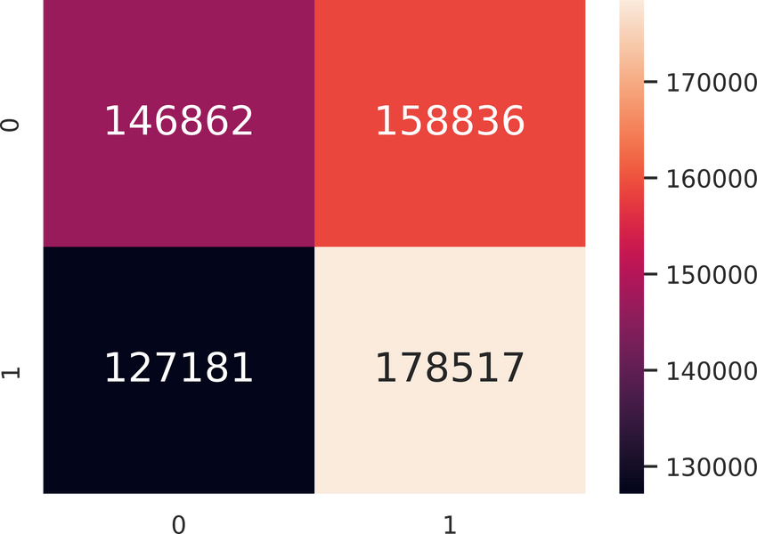
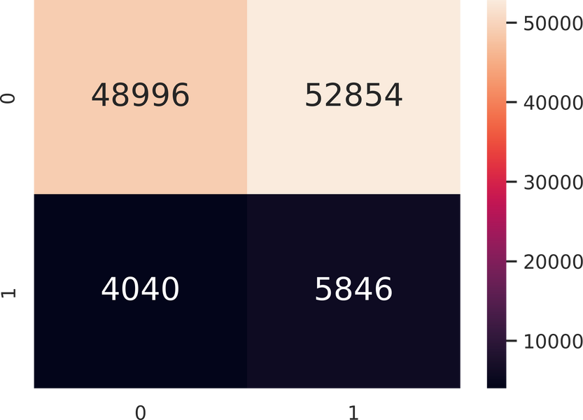
Regan
GENDER:
Classification Accuracy in train data : 0.5322
Train Data - True Positive Rate : 0.5840
Train Data - False Positive Rate : 0.5196
Train Data - Precision : 0.5292
Train Data - Recall : 0.5840
Train Data - F1 Score : 0.5552
Classification Accuracy in test data : 0.4908
Test Data - True Positive Rate : 0.5913
Test Data - False Positive Rate : 0.51894
Test Data - Precision : 0.09959
Test Data - Recall : 0.5913
Test Data - F1 Score : 0.1705

Slide 43

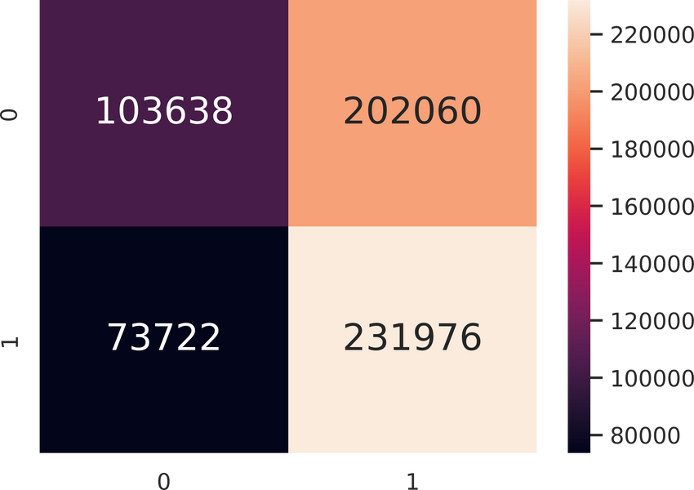
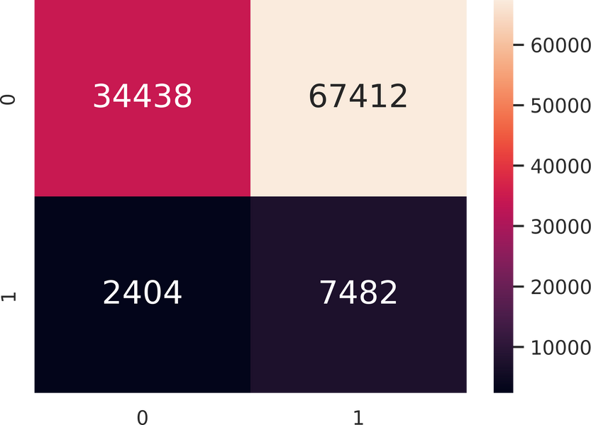
Regan
INCOME_CATEGORY:
Classification Accuracy in train data : 0.5489
Train Data - True Positive Rate : 0.7588
Train Data - False Positive Rate : 0.6610
Train Data - Precision : 0.5345
Train Data - Recall : 0.7588
Train Data - F1 Score : 0.6272
Classification Accuracy in test data : 0.3752
Test Data - True Positive Rate : 0.7568
Test Data - False Positive Rate : 0.6619
Test Data - Precision : 0.09990
Test Data - Recall : 0.7568
Test Data - F1 Score : 0.1765

Slide 44

Regan
SUMMARY
Metric | Customer_Age | Gender | Income_Category
Accuracy | 0.587 | 0.491 | 0.375
True Positive Rate | 0.410 | 0.591 | 0.757 (Best)
False Positive Rate | 0.396 | 0.519 | 0.662
Precision | 0.091 | 0.100 | 0.100
Recall | 0.410 | 0.591 | 0.757
F1 Score | 0.150 | 0.170 | 0.177 (Best)

Slide 45
Regan
CHOICE:
INCOME_CATEGORY
The most effective individual predictor of fraud is Income_Category. This is because it achieves the highest F1 Score (0.177) among the compared features, which balances both precision and recall—two crucial metrics in fraud detection.

Slide 46
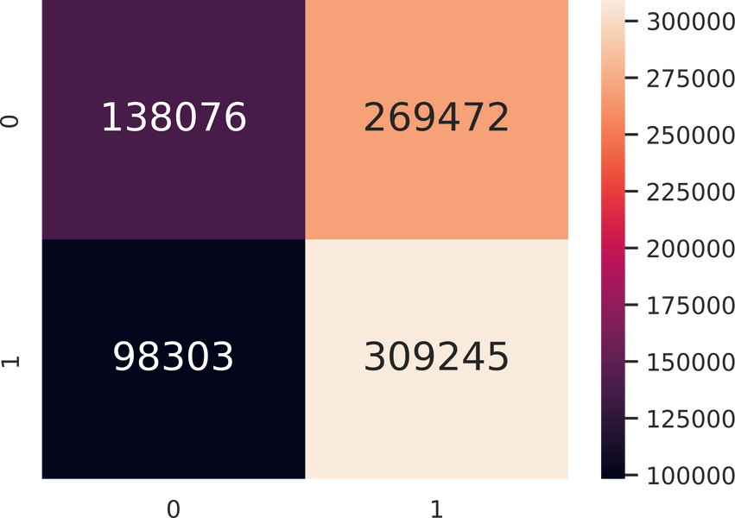
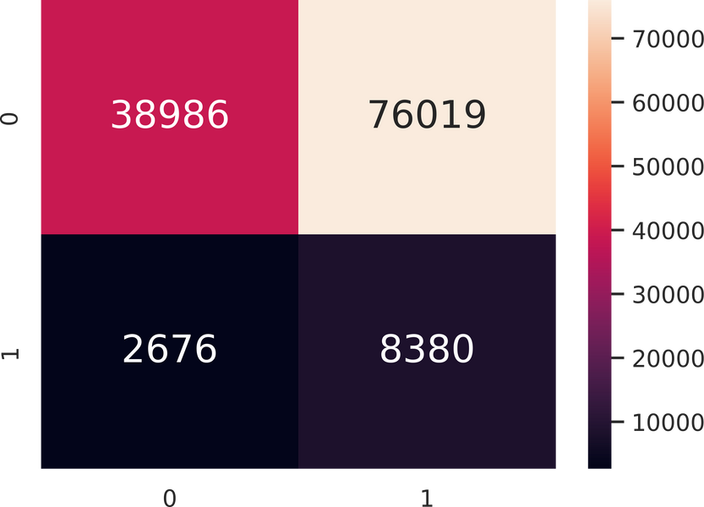
Regan
INCOME_CATEGORY:
ACTUAL TEST DATA
Classification Accuracy in train data : 0.5488
Train Data - True Positive Rate : 0.7588
Train Data - False Positive Rate : 0.6612
Train Data - Precision : 0.5344
Train Data - Recall : 0.7588
Train Data - F1 Score : 0.6271
Classification Accuracy in test data : 0.3757
Test Data - True Positive Rate : 0.7580
Test Data - False Positive Rate : 0.6610
Test Data - Precision : 0.09929
Test Data - Recall : 0.7580
Test Data - F1 Score : 0.1756

Slide 47
Regan
PERFORMANCE
  F1 Score: 0.176
  True Positive Rate: 75.8%
Income_Category showed consistent performance on the test set and remained the most effective single predictor for fraud detection, with a high recall and stable F1 score.

Slide 48

Regan
CONCLUSION
  It is clear to use that out of all the different Prediction models we've used, we have found that Random Forest Classification method has the highest accuracy for predicting fraud in our data set.
  We have also found that 3 predictors played an impactful part in the predictions, which are Gender, Income_Category and Customer_Age. With Income_Category being the best predictor out of the 3.

Slide 49
THANK YOU

Slide 50
TASK DISTRIBUTION
Main Task | Assigned To | Metric Number
Data Preparation & Visualization | Khoo Ze Hou | U2321831K
Model Selection (Classification) | Su Kai Cheng, Joseph | U2422890F
Model Selection (Regression) | Suhanesh Balakrishnan | U2322386F
Individual Predictor & Conclusion | Chew Chern Wei, Regan | U2321414K

